Slide 1

QER- 10719
QER: AGOGO FULL FIELD DEVELOPMENT (NDUNGU) SF300824C005.F1-F8 - Zeta wires unlocking

Slide 2
Pipe section / Details
Item | Traceability / identification
Project number | SF300824C005
Project name | AGOGO FULL FIELD DEVELOPMENT (NDUNGU)
Pipe section | SF300824C005.F1 – F8
ST number | ST050.10529
Affected layer / equipment | Zeta pressure vault spiraling
Length affected | 1336.8m till 1336.9m
Drawing number / MP code / STA / Dimension | Zeta wire 6.2 FI09 (MP205)

Slide 3
Overview of anomaly
Problem Description :-
During the zeta spiraling of AGOGO FULL FIELD DEVELOPMENT (NDUNGU) SF300824C005.F1-F8 (ST050.10529), zeta wire unlocked was detected at length 1336.8m to 1336.9m on the pipe.
Root Cause :-
The suspected root cause was due to:
1. Unbalance brake tension between 2 bobbins.
2. Pipe unstable during running with max speed 100% due to issue with mousetrap no.1 (the shaft bent cause motor trip).
Problem Handling:-
Reparation by un-spiral has been performed to re-position the wires to be in a good spiral. Thus, this reparation was accepted as it is and the dimensional after the repair is within the criteria.

Slide 4
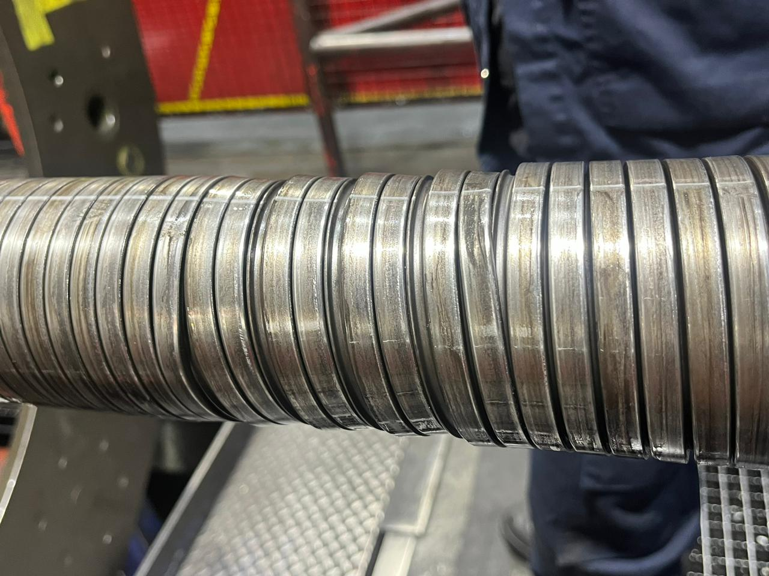
Defect Photo
Length 1336.8m
Length 1336.9m
Figure 1 : Zeta wire unlocked was detected at length 1336.8m to 1336.9m on the pipe.

Slide 5
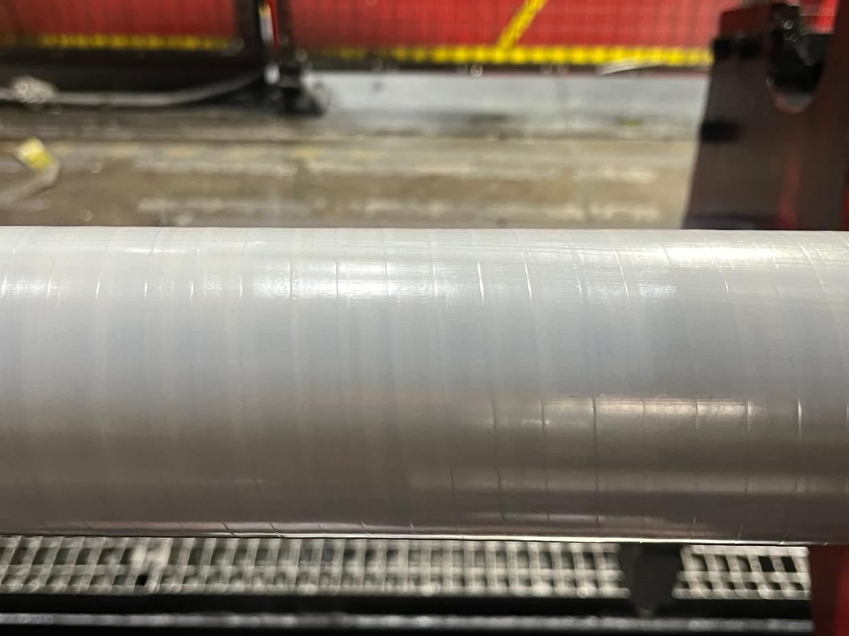
Pressure Sheath Surface
Figure 2 : Surface condition of pressure sheath after complete un-spiral.

Slide 6
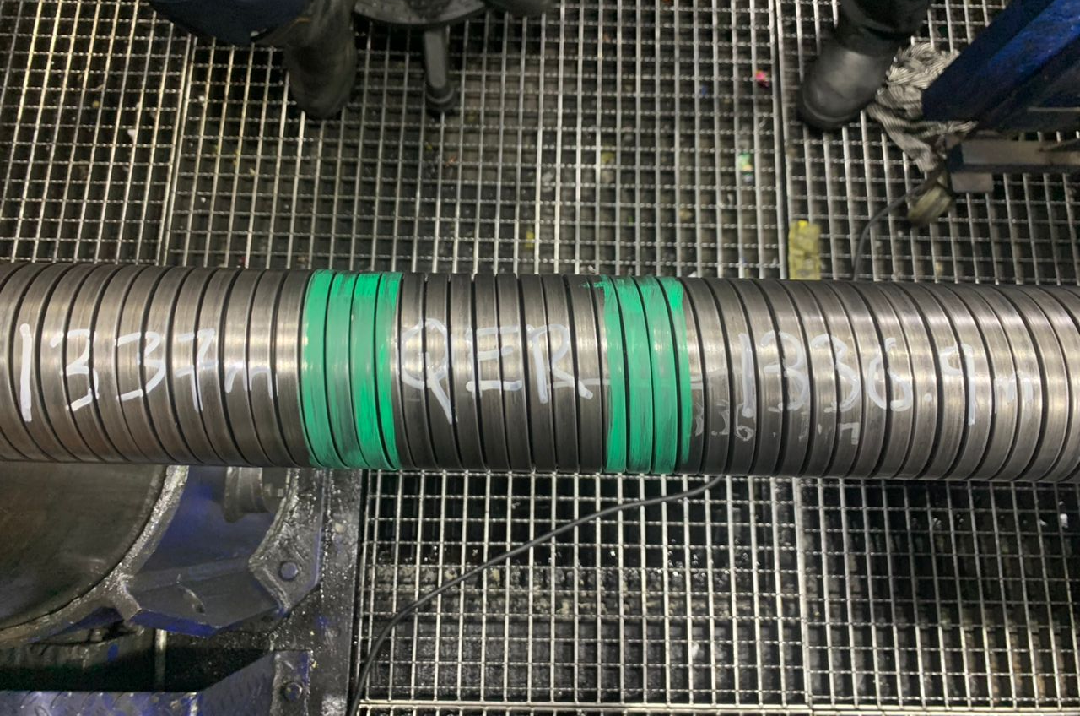
Photo After Repaired
Figure 3 : Reparation by un-spiral has been performed to re-position the wires to be in a good spiral. Thus, this reparation was accepted as it is and the dimensional after the repair is within the criteria.

Slide 7

THANK YOU

